Slide 1

Introduction to Transport Layer
Lecture 4 | CSE421 – Computer Networks
Department of Computer Science and Engineering School of Data & Science

Slide 2

Objectives
Our goals:
understand principles behind transport layer services
learn about two transport layer protocols:
UDP: User Datagram Protocol
TCP: Transmission Control Protocol

Slide 3
Transport vs. Network layer
transport layer: logical communication between processes
network layer: logical communication between hosts
household analogy:
12 kids in Ann’s house sending letters to 12 kids in Bill’s house:
hosts = houses
processes = kids
app messages = letters in envelopes
transport protocol = Ann and Bill who demux to in-house siblings
network-layer protocol = postal service
Transport Layer PDU is called Segments

Slide 4
Functions of the Transport Layer
Primary responsibilities:
Segmenting the data and managing each piece.
Reassembling the segments into streams of application data.
Identifying the different applications.
Multiplexing
Initiating and terminating a session.
Performing flow control between end users.
Enabling error recovery.
Reliability

Slide 5


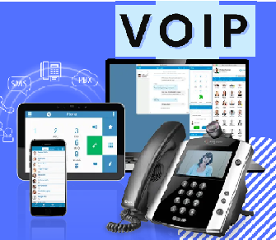
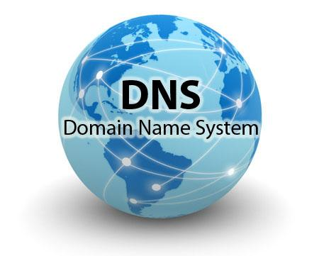

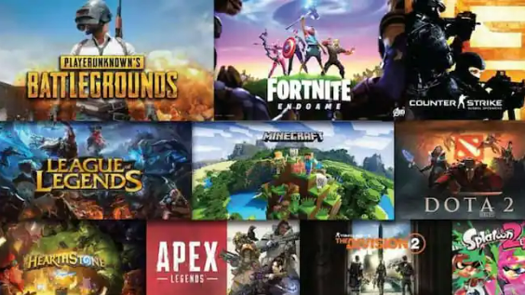
Different Applications
Different Requirements
Web Applications
Emails
Online Games
Some applications need their data to be complete with no errors or gaps and they can accept a slight delay to ensure this.
Some applications can accept occasional errors or gaps in the data but they cannot accept any delay.

Slide 6
Solution : Two transport protocols?
Web Applications
Reliable
TCP
Emails
Fast
UDP
Online Games

Slide 7
UDP: User Datagram Protocol [RFC 768]
UDP Protocol
why is there a UDP?
“no frills,” “bare bones” transport layer protocol
“best effort” service
no connection establishment (which can add delay)
simple: no connection state at sender, receiver
small header size
no congestion or error control: UDP can blast away as fast as desired

Slide 8
User Datagram Protocol (UDP)
UDP is used by:
streaming multimedia apps (loss tolerant, rate sensitive)
SNMP
But sometimes ……
DNS
HTTP/3
reliable transfer over UDP:
add reliability at application layer
application-specific error recovery!

Slide 9
Functions of the Transport Layer
Primary responsibilities:
Segmenting the data and managing each piece.
Reassembling the segments into streams of application data.
Identifying the different applications.
Multiplexing
Establishing and terminating a connection
Enabling error recovery.
Performing flow control between end users.
UDP &TCP
Only TCP

Slide 10
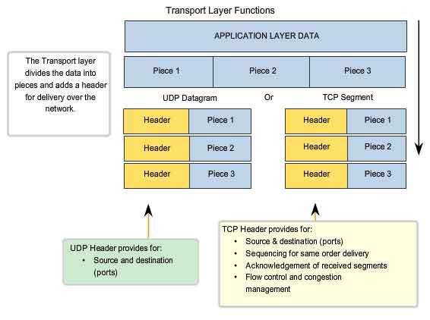
Function 1&2 – Segmentation and Reassembly

Slide 11
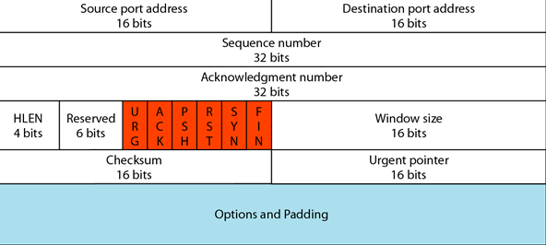

TCP and UDP Headers
TCP HEADER
UDP HEADER

Slide 12
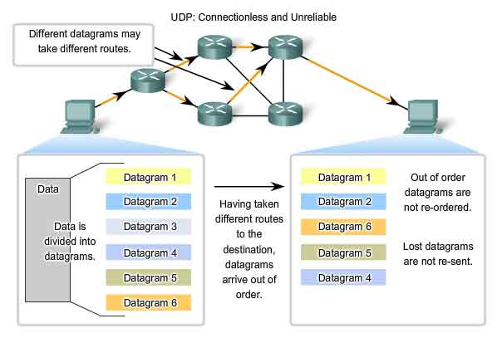
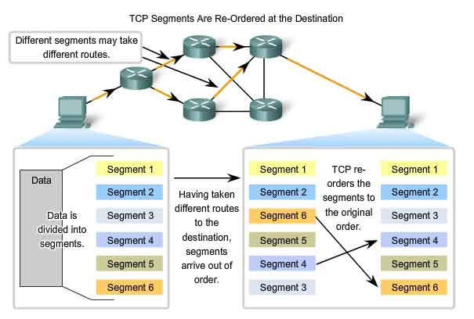
Function 2 – Reassembly
UDP
TCP

Slide 13
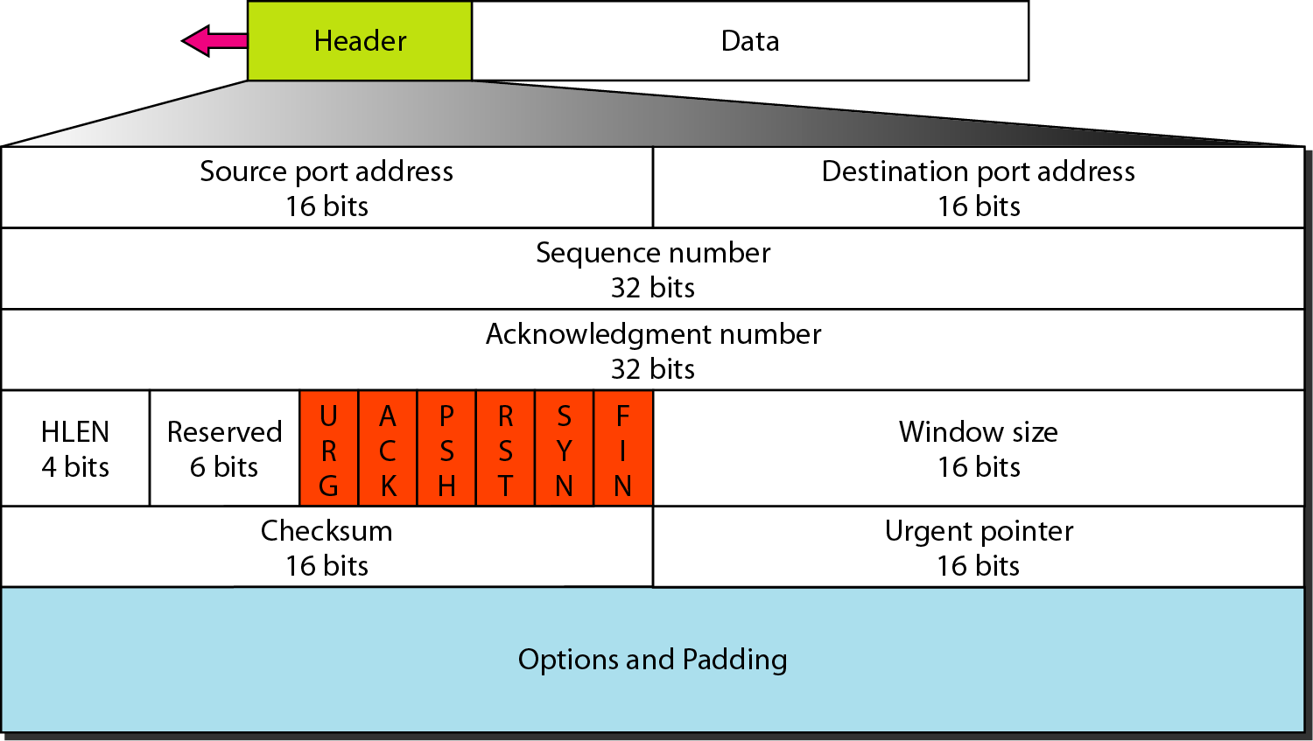
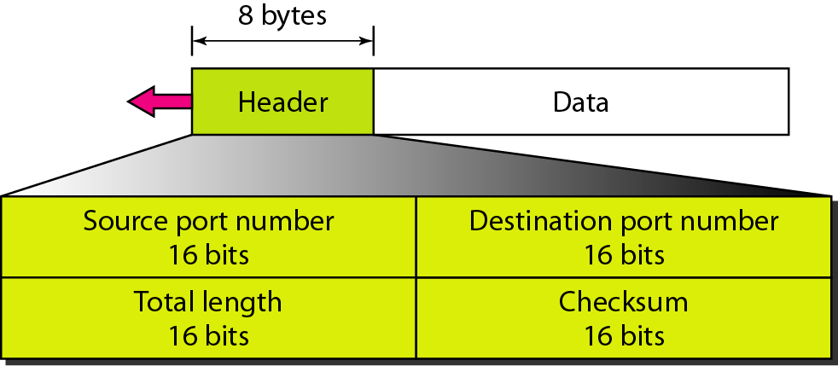
TCP and UDP Headers
TCP Header
UDP Header

Slide 14
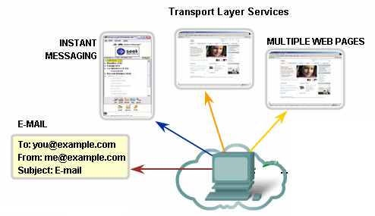
Function 3 – Identifying Different Applications
Port Numbers/Addresses are used to identify different applications/processes running in a computer
16-bits in length
Represented as one single decimal number
Range 0 - 65535
e.g. 80 – Web; 25 – SMTP
110 – POP3, 531 – Instant Messaging

Slide 15
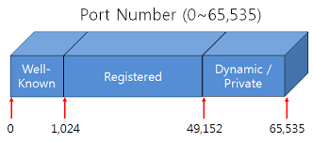
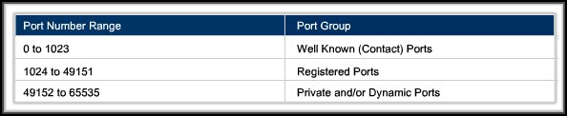
Port Numbers
Internet Corporation for Assigned Names and Numbers (ICANN) assigns port numbers.
Three categories:

Slide 16
Port Number Types
Well-Known Ports:
Reserved for common services and applications.
Assigned by IANA and controlled
20&21 – FTP
443 – HTTPS
25 – SMTP
143 – IMAP
80 – HTTP
110 – POP3
23 – Telnet
53 - DNS

Slide 17
Port Number Types
Registered Ports:
Not assigned or controlled by IANA
Can be registered as the default port for a lot of not-so-well-known, especially corporate/proprietary protocols.
Must request IANA
8008 – Alternate HTTP
1863 – MSN Messenger
5004 – RTP
8080 – Alternate HTTP
5060 – SIP (VoIP)

Slide 18
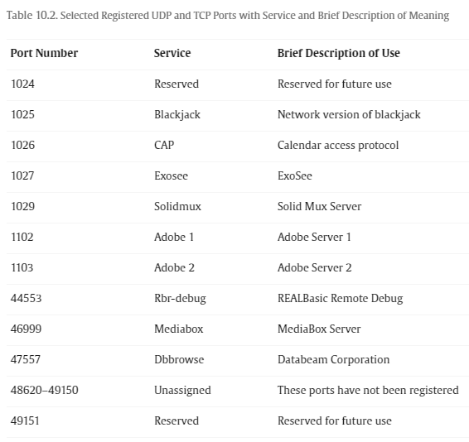
Examples of Registered Ports

Slide 19
Port Number Types
Dynamic Ports:
Also known as private or ephemeral ports
Never assigned or controlled by IANA.
Dynamic port usage will become clearer as we move through the material.

Slide 20
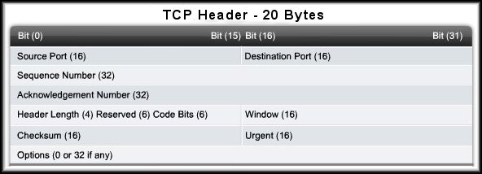
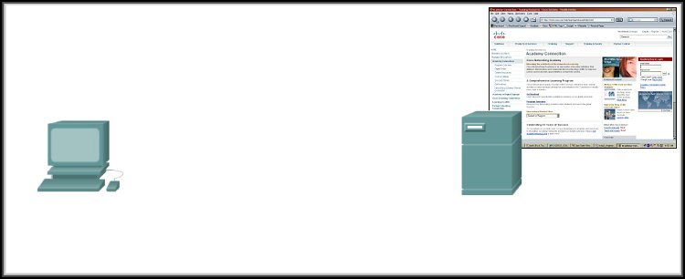
More on Port Numbers
Source = 49650 Destination = 80
Server is listening on Port 80 for HTTP connections.
The client sets the destination port to 80 and uses a dynamic port as its source.

Slide 21
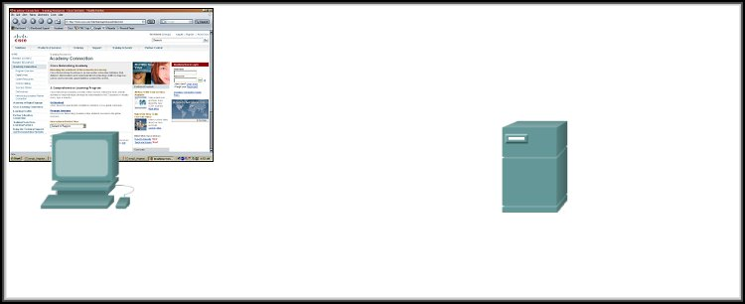
Port Numbers in Action
Source = 80 Destination = 49650
Server replies with the web page.
Sets the source port to 80 and uses the client’s source port as the destination.

Slide 22
Port Numbers in Action
Source = 49650 Destination = 80
Source = 80 Destination = 49650
Notice how the source and destination ports are used.
Clients can use any random port number, servers can’t.
Because clients won’t be able to identify server process otherwise
Servers, however, cannot use any random port number
Use of well-known port numbers!

Slide 23
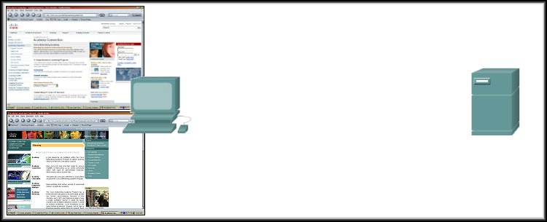
Port Numbers in Action
Source = 49650 Destination = 80
Source = 80 Destination = 49650
172.16.230.5
207.22.146.33
Source = 49655 Destination = 80
Source = 80 Destination = 49655
What if there are two sessions to the same server?
The client uses another dynamic port as its source and the destination is still port 80.
Different source ports keep the sessions unique on the server.

Slide 24
Port Numbers in Action
Source = 49650 Destination = 80
Source = 80 Destination = 49650
172.16.230.5
207.22.146.33
Source = 49655 Destination = 80
Source = 80 Destination = 49655
What if there are two tabs in the same PC?
The client uses another dynamic port as its source and the destination is still port 80.
Different source ports keep the sessions unique.

Slide 25

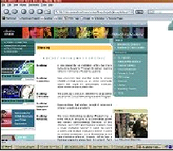



More on Port Numbers in Action
Source = 49650 Destination = 80
172.16.230.5
Source = 49650 Destination = 80
207.22.146.33
172.16.230.6
How does the Server’s Transport Layer keep them separate?
The socket (IP Address:Port)
172.16.230.5:49650 172.16.230.6:49650
207.22.146.33:80 207.22.146.33:80

Slide 26
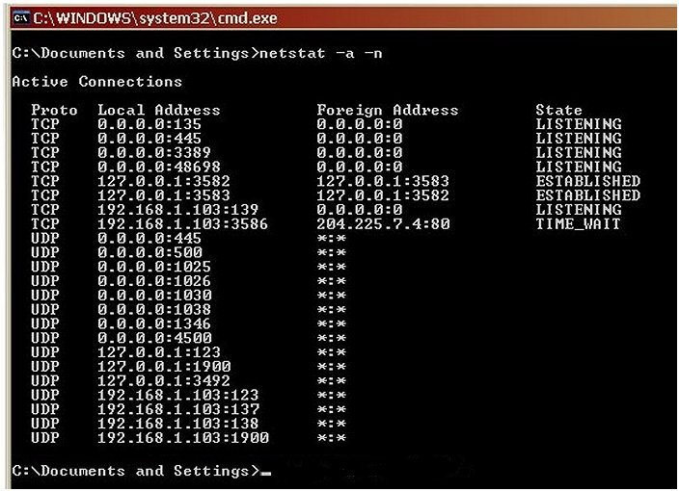
Port Addressing Types and Tools
Source IP
Source Port
Destination IP
Destination Port
TCP/UDP
Netstat - Network Utility Tool
Source Socket
Connection State
Destination Socket
netstat –a –n command

Slide 27

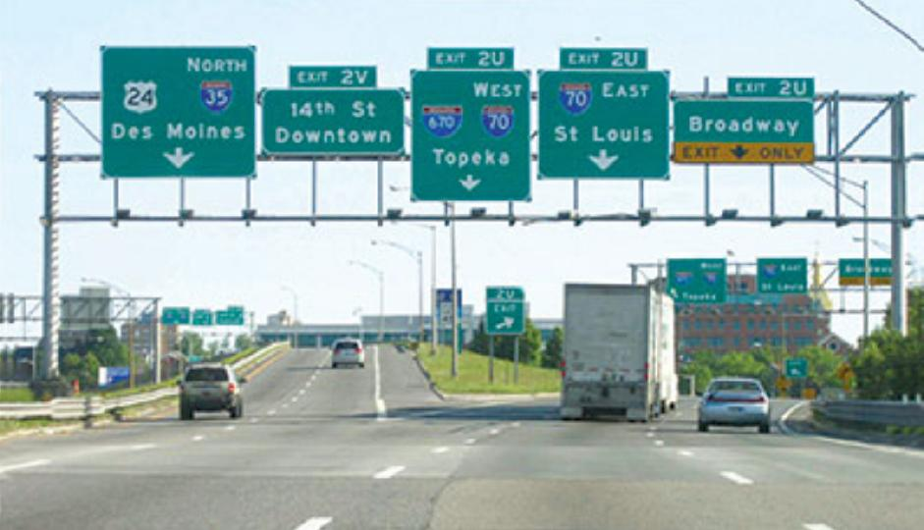


Function 4 –DeMultiplexing/ Multiplexing
application
?
transport
Demultiplexing
Demultiplexing

Slide 28
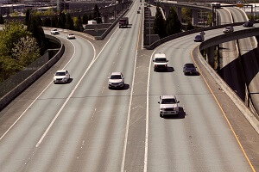
Function 4 –DeMultiplexing/ Multiplexing
application
transport
Multiplexing
multiplexing

Slide 29
How demultiplexing works
host receives IP datagrams/packets
each packet has source IP address, destination IP address
each packet carries one transport-layer segment
each segment has source, destination port number
host uses IP addresses & port numbers to direct segment to appropriate socket
32 bits
source port #
dest port #
other header fields
application
data
(payload)
TCP/UDP segment format

Slide 30

UDP demultiplexing: an example
mySocket = socket(AF_INET,SOCK_DGRAM)
mySocket.bind(myaddr,6428);
mySocket = socket(AF_INET,SOCK_STREAM)
mySocket.bind(myaddr,9157);
mySocket = socket(AF_INET,SOCK_STREAM)
mySocket.bind(myaddr,5775);
application
application
P1
application
P3
P4
transport
transport
network
transport
network
link
network
link
physical
link
physical
physical
B
D
source port: 6428
dest port: 9157
source port: ?
dest port: ?
A
C
source port: 9157
dest port: 6428
source port: ?
dest port: ?

Slide 31

TCP demultiplexing: example
application
application
P4
P5
P6
application
P1
P2
P3
transport
transport
network
transport
network
link
network
link
physical
link
physical
server: IP address B
physical
host: IP address A
source IP,port: B,80
dest IP,port: A,9157
host: IP address C
source IP,port: C,5775
dest IP,port: B,80
source IP,port: A,9157
dest IP, port: B,80
source IP,port: C,9157
dest IP,port: B,80
Three segments, all destined to IP address: B,
dest port: 80 are demultiplexed to different sockets

Slide 32
DeMultiplexing/ Multiplexing
Multiplexing, demultiplexing: based on segment, datagram header field values
UDP: demultiplexing using destination port number (only)
TCP: demultiplexing using 4-tuple: source and destination IP addresses, and port numbers
Multiplexing/demultiplexing happen at all layers

Slide 33
And Now more on TCP!

